Slide 1


Smart India Hackathon
Organization Name: AICTE, MIC-Student Innovation PS Code: SIH1495 Problem Statement Title: Student Innovation Team Name: The Visioneers Team Leader Name: Pritam Bijarniya
Institute Code (AISHE): U-0741 Institute Name: JECRC University Theme Name: Smart Automation

Slide 2

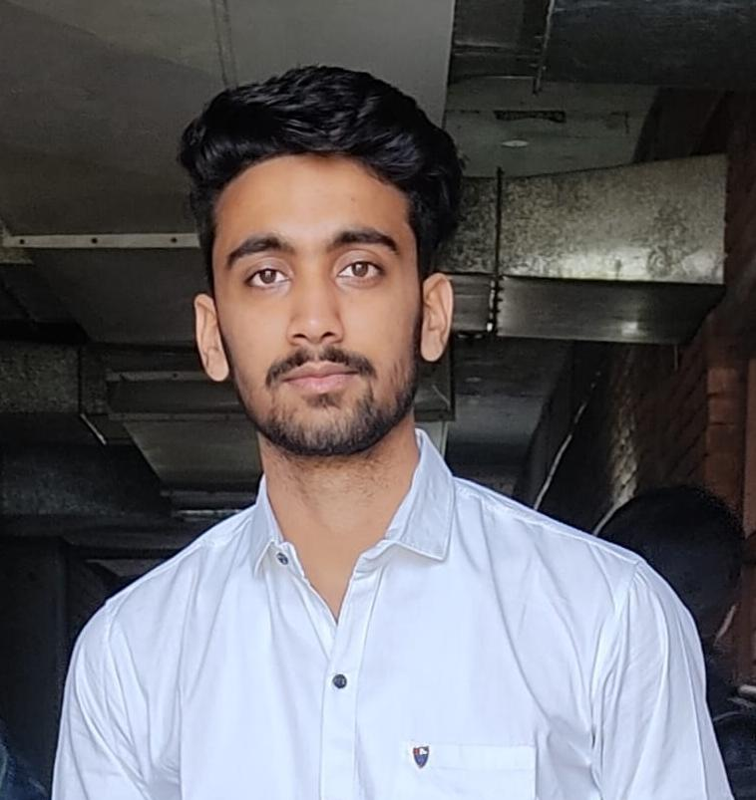
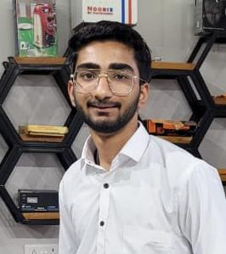


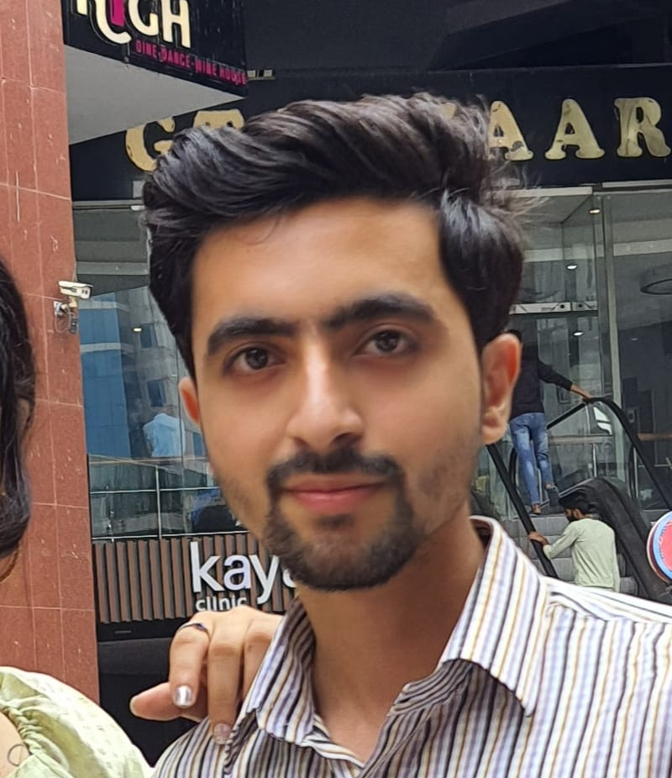

Meet Our Visioneers
Pritam Bijarniya
Siddhant Khandelwal
BCA
2nd Year
B.Tech
2nd Year
Nishant Khandelwal
Steve P Michael
BCA
2nd Year
B.Tech
2nd Year
Nikhil Kalra
Avantika Sharma
BCA
2nd Year
BCA
2nd Year

Slide 3
Problem Statement
Individuals face significant challenges in identifying and connecting with the right people. Many people on the freelancing sites are not efficient enough, or do not get paid for their work. Sometimes the employer scams employees.
There is no platform to cater to the needs on a small scale, like for finding someone for a team from the college, or finding a person with same interests.
The absence of a dedicated platform tailored to efficiently match skills, location, and educational backgrounds hinders effective networking, collaboration, and resource discovery.
People looking for organizing the competitions and tournaments can easily have this platform to get the audience for competing in them.
Students from tier 3-4 colleges don’t have access to competitions on a good level, this platform can organize competitions, tournaments for interested individuals.

Slide 4
Skill Fusion
“Uniting skills, Building Futures : Where Expertise Meets Opportunity”
We are creating a dynamic online community where individuals unite and collaborate seamlessly based on their unique skills and expertise.
Our platform serves as a virtual bridge, bringing together people from various backgrounds, professions and educational institutions.
Users can create comprehensive profiles highlighting their skills, experiences, and educational backgrounds.
Whether you are a business owner looking for the perfect candidate to fill a crucial role for the
company, student seeking guidance and mentorship, . our platform has you covered.

Slide 5
Skill Fusion
We provide certified, expert and experienced users that would help the students as well as teachers and working professionals to unite and create teams or groups to implement their ideas into reality.
Students can collaborate to work on projects, hackathon, ideathon, events, curricular activities, competitions and many more.
Individuals can put their ideas on our platform and find professional and specialist to transform the idea into actuality.
We would provide unique sorting and filtering system that allows users to pinpoint potential collaborators by geographical location, educational institutions, skills, certification, streams and expertise.
Join us in revolutionizing the way people connect and collaborate. Discover the power of tailored connections, where the right skills meet the right opportunities.

Slide 6
SKILL FUSION
Individuals
Ideas
Innovations
Engagements
Data Collections
Sorting
Searching
Freelancing
Skills
Area Wise
Expertise
Collaborations
Job Opportunities
Certificates
Skills
Groups
Projects
Teams

Slide 7
Technology Stack
Components | Technologies
Machine learning frameworks | TensorFlow, PyTorch, Keras
Programming Languages | Python, Julia, R, C++, C, Java
Data preprocessing | NumPy, Pandas, OpenCV
Visualization | Matplotlib, Seaborn, Plotly
Other tools | Jupyter Notebook, Anaconda, Git
Deployment | Flask, Docker, Kubernetes
Cloud services | AWS, GCP, Azure, SQL, MongoDB
Frameworks | Frontend and Backend
Operating System | Linux, iOS, Android

Slide 8
Idea Details (Use Cases)
Talent Acquisition For Businesses.
Freelance and Gig Opportunities.
Collaborative Projects.
Networking For Events And Conferences.
Skill Based Volunteering.
Professional Development.
Knowledge Sharing.
Localized Services.
Alumni And Educational Networks.
Help In Maintaining CVs And Resumes.
Job Opportunities.
Mentorship.
Help In Gaining Certificates.
Roadmaps And Ideas.
Collecting students with different skills for hackathons, ideathons and events with fully skilled members.

Slide 9
Dependencies
Data Accuracy
Marketing And Promotion
Data privacy Concerns
Competition
Technical Issues

Slide 10




Thank you

